Slide 1
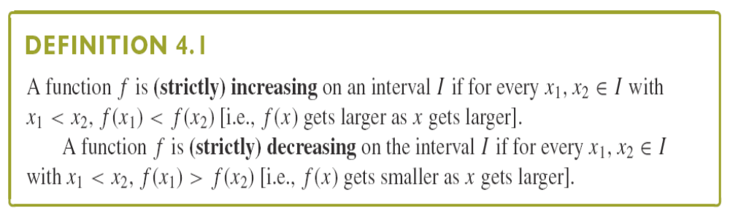
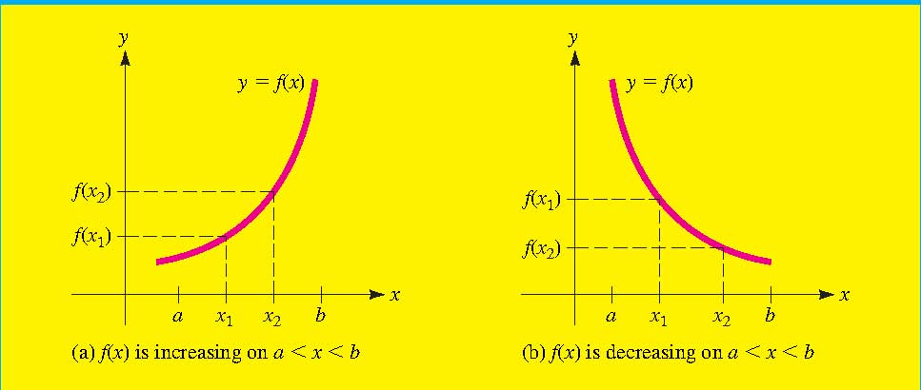
Section 3.4 Increasing and Decreasing Functions (函数的上升和下降)
Monotonic Increasing
Monotonic
Decreasing

Slide 2

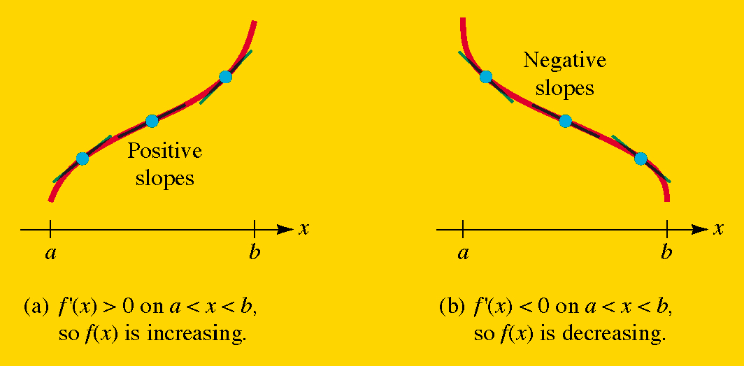


Tangent line with positive slope
f(x) will be increasing
Tangent line with negative slope
f(x) will be decreasing

Slide 3
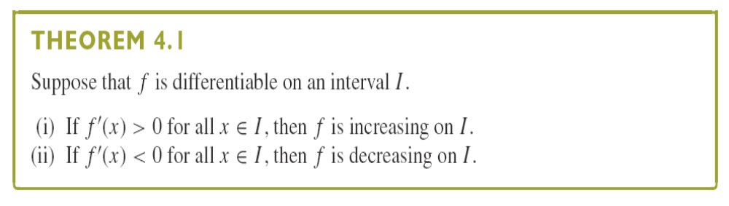
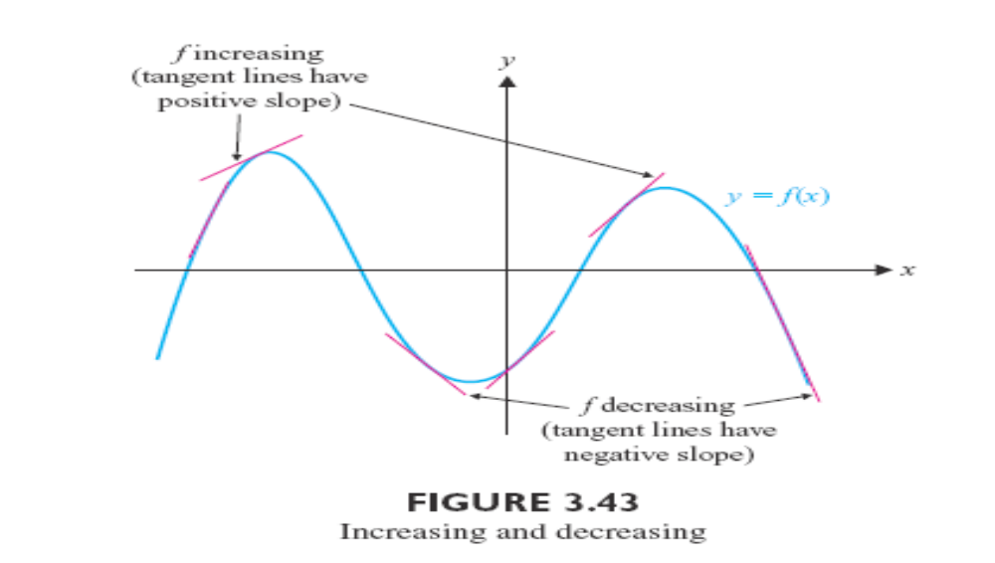

Slide 4
How to determine all intervals of increase and decrease
for a function ? How to find all intervals on which the sign of the derivative does not change.
Intermediate value property
A continuous function cannot change sign without first becoming 0.

Slide 5





Procedure for using the derivative to determine intervals of increase and decrease for a function of f.
Step 1. Find all values of x for which or is
not defined, and mark these numbers on a number line. This
divides the line into a number of open intervals.
Step 2. Choose a test number c from each interval a<x<b
determined in the step 1 and evaluate . Then
If the function f(x) is increasing on a<x<b.
If the function f(x) is decreasing on a<x<b.

Slide 6
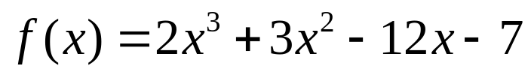
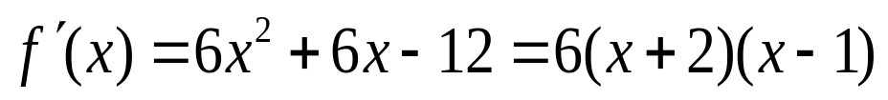

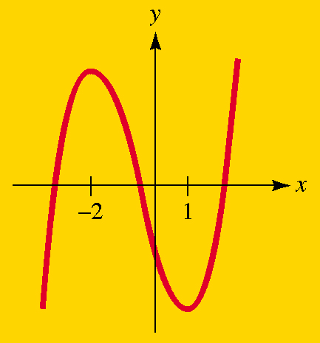



Example
Find the intervals of increase and decrease for the function
Solution:
The derivative of f(x) is
which is continuous everywhere, with where x=1 and x=-2. The number -2 and 1 divide x axis into three open intervals.
x<-2, -2<x<1 and x>1.
^{Interval}
^{Test}
^{Number}
^{Conclusion}
^{Direction}
^{of graph}
^{x<-2}
⁻ ³
^{f is increasing}
^{Rising}
^{-2<x<1}
⁰
^{f is deceasing}
^{Falling}
^{x>1}
²
^{f is increasing}
^{Rising}

Slide 7
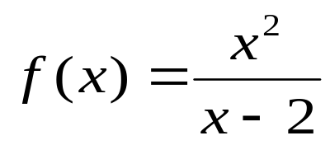
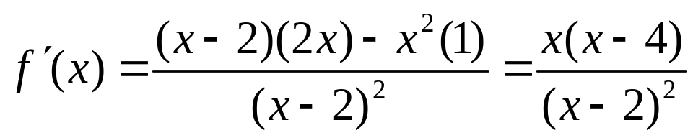
Example
Find the interval of increase and decrease for the function
Solution:
The function is defined for x≠2, and its derivative is
which is discontinuous at x=2 and has f’(x)=0 at x=0 and x=4. Thus, there are four intervals on which the sign of f’(x) does not change: namely, x<0, 0<x<2, 2<x<4 and x>4. Choosing test numbers in these intervals (say, -2,1,3, and 5, respectively), we find that
To be continued

Slide 8
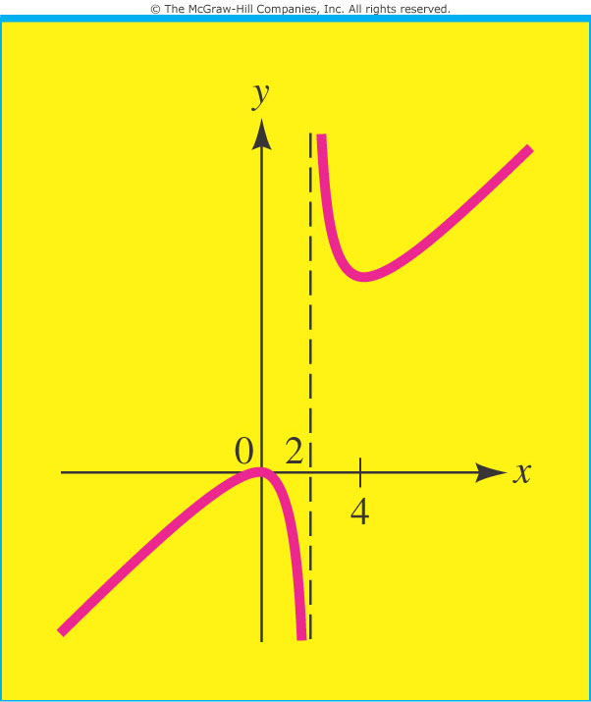
We conclude that f(x) is increasing for x<0 and for x>4 and that it is decreasing for 0<x<2 and for 2<x<4.

Slide 9
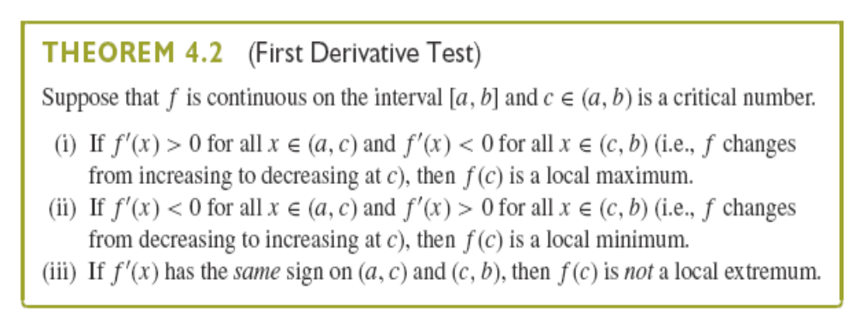
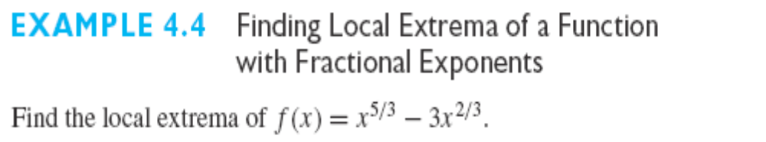

Slide 10
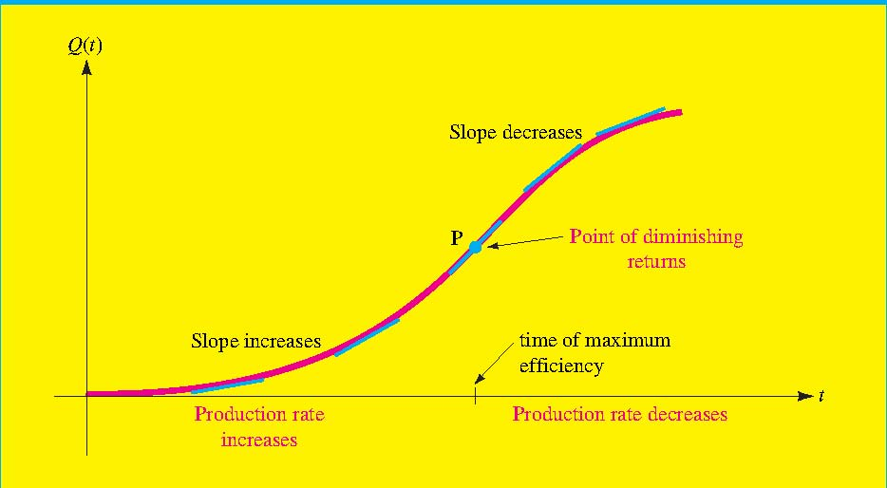
Section 3.5 Concavity (凹凸性) and The Second Derivative Test
Increase and decrease of the slopes are our concern!
Figure: The output Q(t) of a factory worker t hours after coming to work.

Slide 11
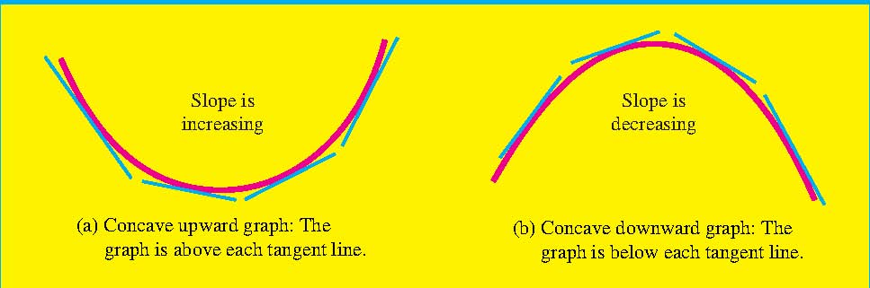
Concavity: If the function f(x) is differentiable on the interval a<x<b then the graph of f is
Concave up on a<x<b if is increasing on
the interval
Concave down on a<x<b if is decreasing
on the interval

Slide 12
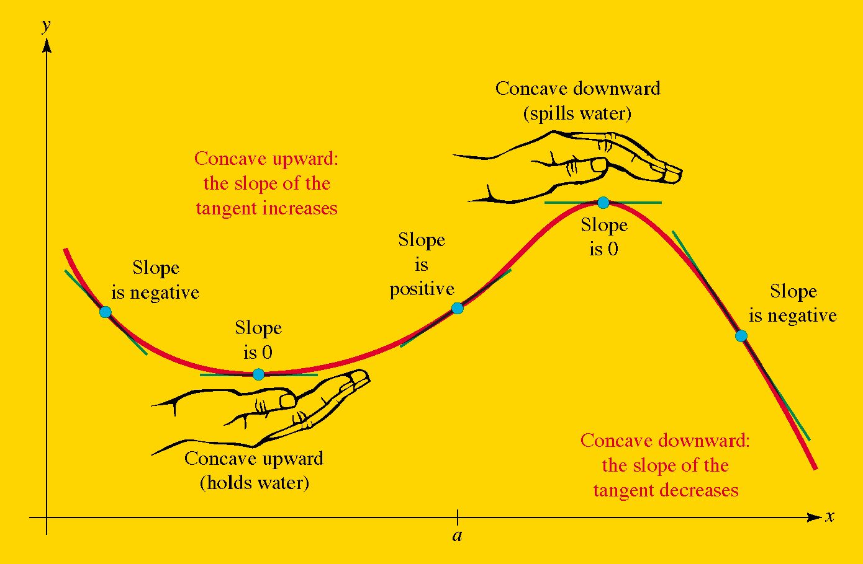
A graph is concave upward on the interval if it lies above all its tangent lines on the interval and concave downward on an Interval where it lies below all its tangent lines.

Slide 13
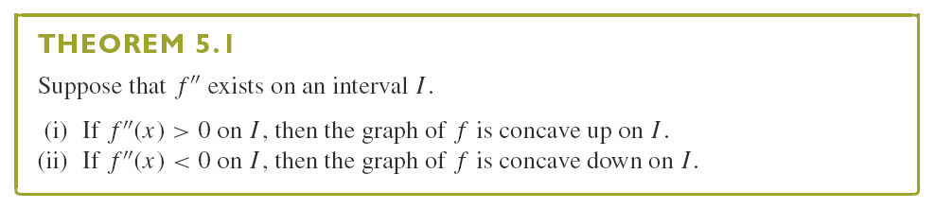

Slide 14





Determining Intervals of Concavity Using the Sign of f’’
Step 1. Find all values of x for which or is not defined, and mark these numbers on a number line. This divides the line into a number of open intervals.
Step 2. Choose a test number c from each interval a<x<b
determined in the step 1 and evaluate . Then
If , the graph of f(x) is concave upward on
a<x<b.
If , the graph of f(x) is concave downward on
a<x<b.

Slide 15


Example
Determine intervals of concavity for the function
Solution:
We find that and
The second derivative f’’(x) is continuous for all x and f’’(x)=0 for x=0, x=1, and x=-1. These numbers divide the x axis into four intervals on which f’’(x) does not change sign; namely, x<1, -1<x<0, 0<x<1, and x>1. Evaluating f’’(x) at test numbers in each of these intervals (say, at x=-2, x=-1/2, x=1/2, and x=5, respectively), we find that
to be continued

Slide 16
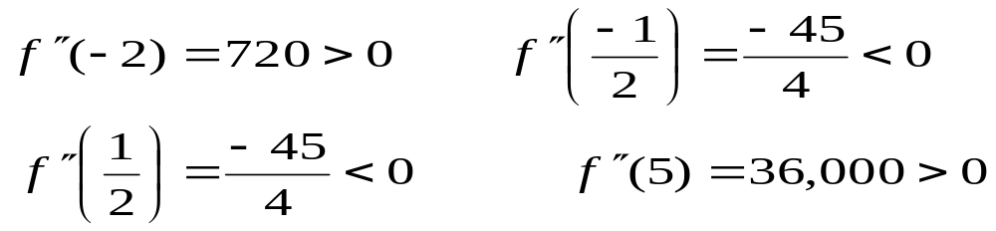

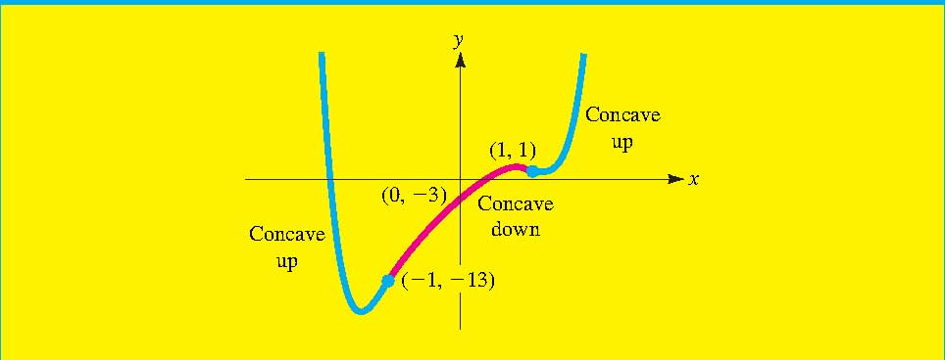
Thus, the graph of f(x) is concave up for x<-1 and for x>1 and concave down for -1<x<0 and for 0<x<1, as indicated in this concavity diagram.
Type of concavity
Sign of
+ + + +
- - - - - - -
- - - - -
+ + + + +
x
-1
0
1

Slide 17
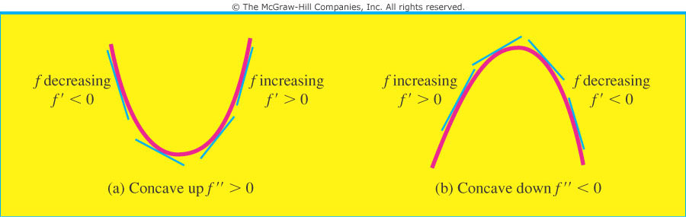
Note Don’t confuse the concavity of a graph with its “direction” (rising or falling). A function may be increasing or decreasing on an interval regardless of whether its graph is concave upward or concave downward on the interval.

Slide 18
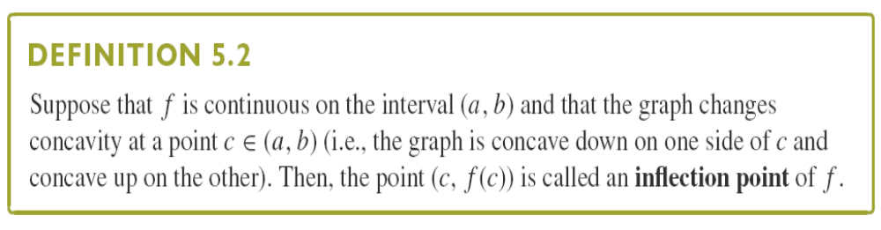
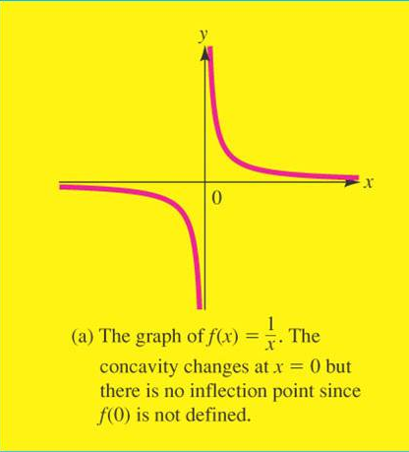
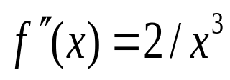
拐点
Note: A function can have an inflection point only where it is continuous!!
For example, if f(x)=1/x, then
, so f’’(x)<0 if x<0 and f’’(x)>0 if x>0. The concavity changes from downward to upward at x=0 but there is no inflection point at x=0 since f(0) is not defined,

Slide 19
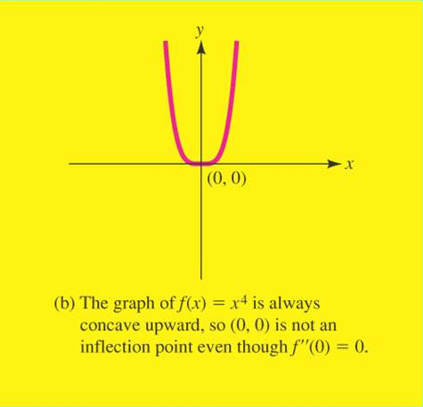
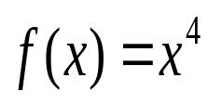

For instance, if , then f(0)=0 and so f’’(0)=0. However, f’’(x)>0 for any number x≠0 , so the graph of f is always concave upward, and there is no inflection point at (0,0).

Slide 20
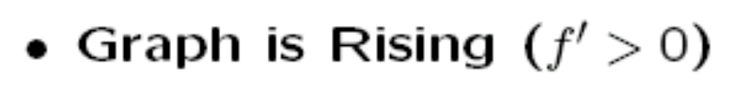
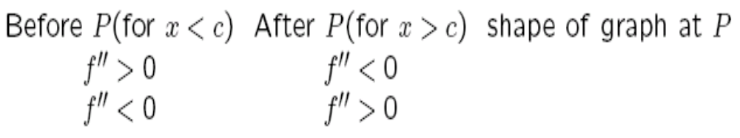
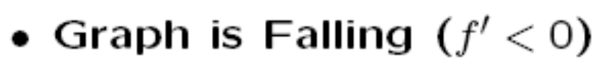
Behavior of Graph f(x) at an inflection point P(c,f(c))

Slide 21
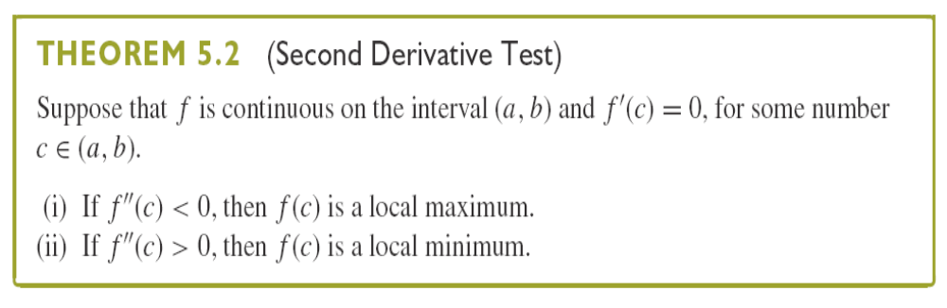
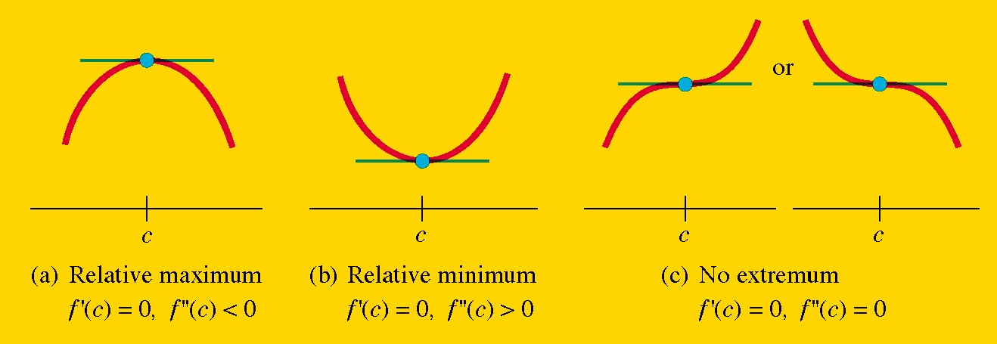

Slide 22
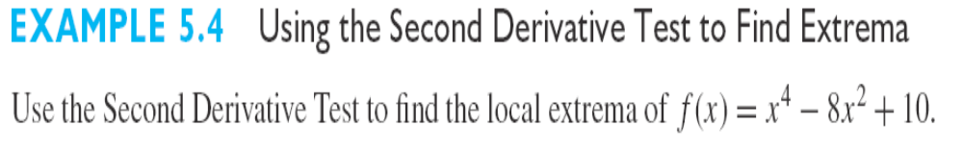
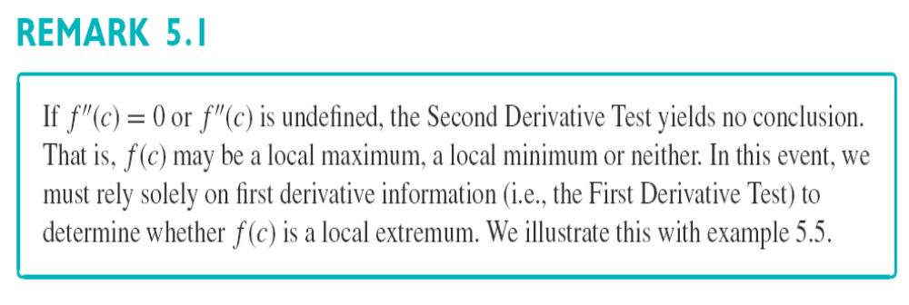
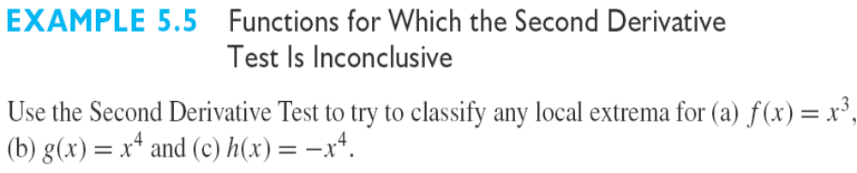

Slide 23
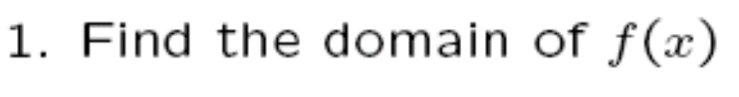
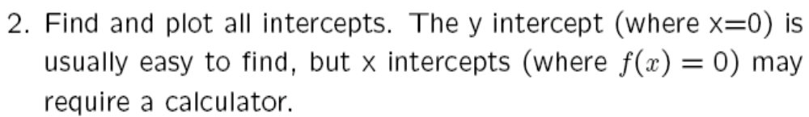
Section 3.5 Overview of Curve Sketching
to be continued

Slide 24
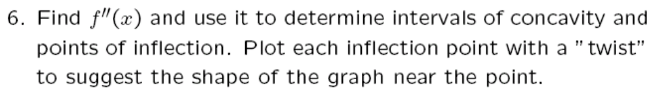
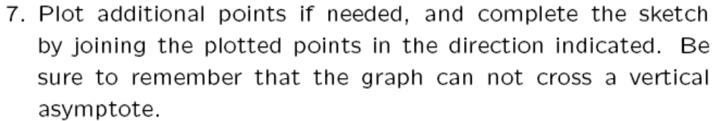

Slide 25
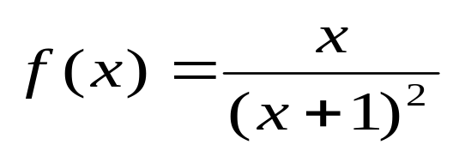
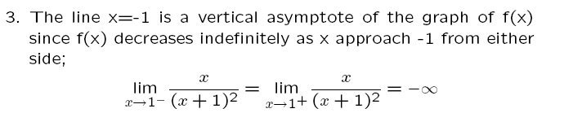
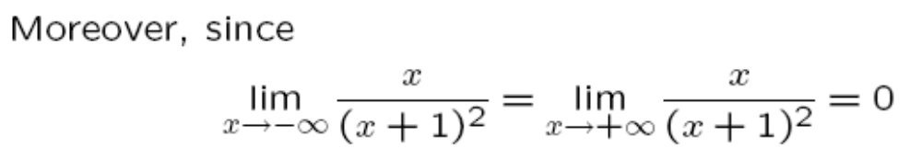
Example 13
Sketch the graph of the function
Solution:
to be continued

Slide 26
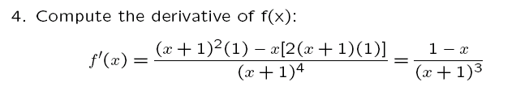
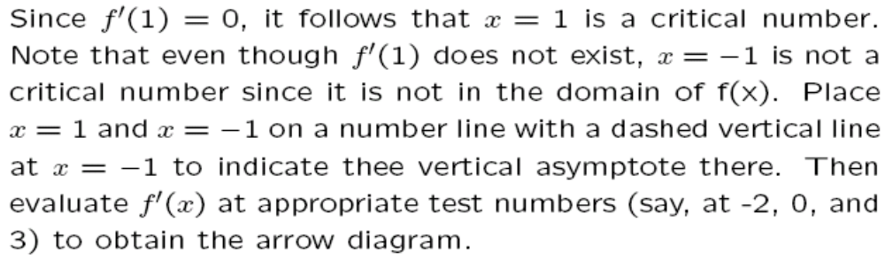
- - - - - -
+ + + +
- - - - - -
to be continued
-1
Asymptote
1
Max

Slide 27
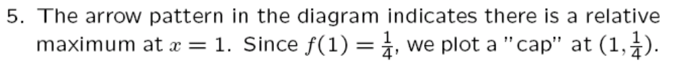
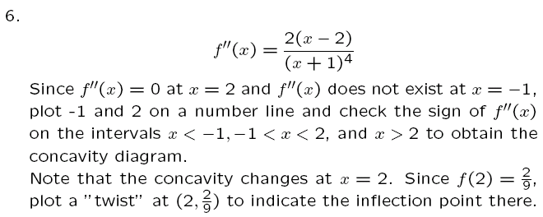
Type of concavity
Sign of
- - - - - -
- - - - -
+ + + + +
-1
No inflection
2
inflection
to be continued

Slide 28
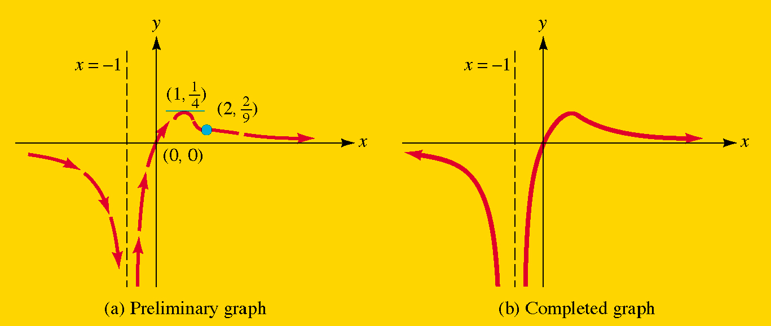
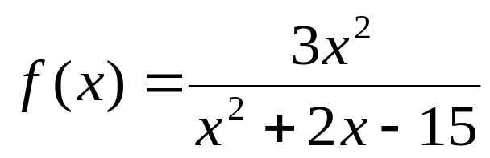
7. The vertical asymptote (dashed line) breaks the graph into two parts. join the features in each separate part by a smooth curve to obtain the completed graph.
Exercise
Sketch the graph of

